Slide 1
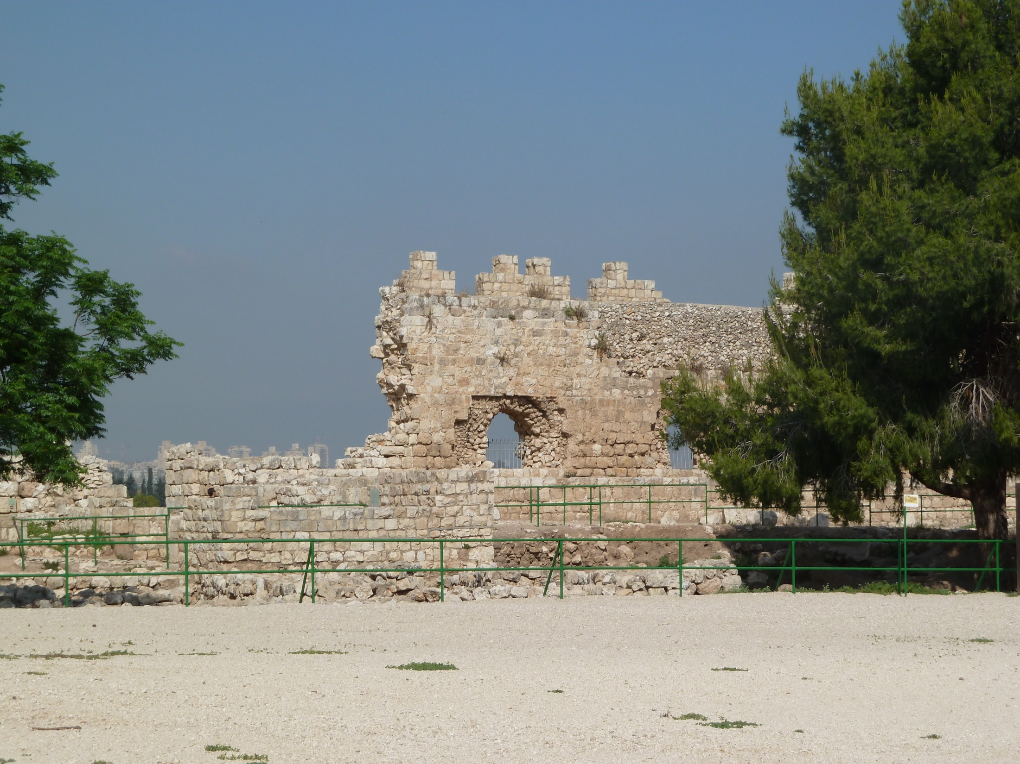
Genesis 4.16-5.32

Slide 2
Genesis 4.16-17 NIV: So Cain went out from the LORD’S presence and lived in the land of Nod, east of Eden. Cain made love to his wife, and she became pregnant and gave birth to Enoch. Cain was then building a city, and he named it after his son Enoch.

Slide 3
Genesis 4.18-19 NIV: To Enoch was born Irad, and Irad was the father of Mehujael, and Mehujael was the father of Methushael, and Methushael was the father of Lamech. Lamech married two women, one named Adah and the other Zillah.

Slide 4
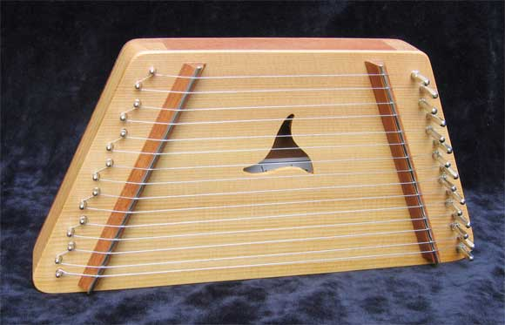
Genesis 4.20-22 NIV: Adah gave birth to Jabal; he was the father of those who live in tents and raise livestock. His brother’s name was Jubal; he was the father of all who play stringed instruments and pipes. Zillah also had a son, Tubal-Cain, who forged all kinds of tools out of bronze and iron. Tubal-Cain’s sister was Naamah.
jamesjonesinstruments.com

Slide 5
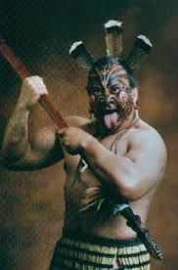
Genesis 4.23-24 NIV: Lamech said to his wives, “Adah and Zillah, listen to me; wives of Lamech, hear my words. I have killed a man for wounding me, a young man for injuring me. If Cain is avenged seven times,
then Lamech seventy-seven times.”

Slide 6
Genesis 4.25-26 NIV: Adam made love to his wife again, and she gave birth to a son and named him Seth, saying, “God has granted me another child in place of Abel, since Cain killed him.” Seth also had a son, and he named him Enosh. At that time people began to call on the name of the LORD.
שִׁית = placed [granted] or ordained
שֵׁת = Seth

Slide 7
Adam [2:20]
Seth [4:25] Cain [4:1] Abel [4:2]
Enosh [4:26] Enoch [4:17]
Kenan [5:9] Irad [4:18]
Mahalalel [5:12] Mehujael [4:18]
Jared [5:15] Methushael [4:18]
Enoch [5:18] Lamech [4:18]
Methuselah [5:21]
Lamech [5:25] Jabal [4:20] Jubal [4:21] Tubal-Cain [4:22]
Noah [5:29]

Slide 8
Genesis 4.25-26 NIV: Adam made love to his wife again, and she gave birth to a son and named him Seth, saying, “God has granted me another child in place of Abel, since Cain killed him.” Seth also had a son, and he named him Enosh. At that time people began to call on the name of the LORD.
קָרָא = call on in prayer or proclaim in worship

Slide 9
Genesis 5.1-2 NIV: This is the written account of Adam’s family line. When God created mankind, he made them in the likeness of God. He created them male and female and blessed them. And he named them “Mankind” when they were created.
Adam and Eve, from “Art in the Christian Tradition,” Vanderbilt Divinity Library, Nashville, TN / diglib.library.vanderbilt.edu. Original source was mfa.org.

Slide 10
Genesis 5.3-5 NIV: When Adam had lived 130 years, he had a son in his own likeness, in his own image; and he named him Seth. After Seth was born, Adam lived 800 years and had other sons and daughters. Altogether, Adam lived a total of 930 years, and then he died.
Adam was created in God’s image
Seth was procreated in Adam’s image

Slide 11
Genesis 5.6-11 NIV: When Seth had lived 105 years, he became the father of Enosh. After he became the father of Enosh, Seth lived 807 years and had other sons and daughters. Altogether, Seth lived a total of 912 years, and then he died. When Enosh had lived 90 years, he became the father of Kenan. After he became the father of Kenan, Enosh lived 815 years and had other sons and daughters. Altogether, Enosh lived a total of 905 years, and then he died.

Slide 12
Genesis 5.12-17 NIV: When Kenan had lived 70 years, he became the father of Mahalalel. After he became the father of Mahalalel, Kenan lived 840 years and had other sons and daughters. Altogether, Kenan lived a total of 910 years, and then he died. When Mahalalel had lived 65 years, he became the father of Jared. After he became the father of Jared, Mahalalel lived 830 years and had other sons and daughters. Altogether, Mahalalel lived a total of 895 years, and then he died.

Slide 13
Genesis 5.18-24 NIV: When Jared had lived 162 years, he became the father of Enoch. After he became the father of Enoch, Jared lived 800 years and had other sons and daughters. Altogether, Jared lived a total of 962 years, and then he died. When Enoch had lived 65 years, he became the father of Methuselah. After he became the father of Methuselah, Enoch walked faithfully with God 300 years and had other sons and daughters. Altogether, Enoch lived a total of 365 years. Enoch walked faithfully with God; then he was no more, because God took him away.

Slide 14
Genesis 5.21-24 NIV: When Enoch had lived 65 years, he became the father of Methuselah. After he became the father of Methuselah, Enoch walked faithfully with God 300 years and had other sons and daughters. Altogether, Enoch lived a total of 365 years. Enoch walked faithfully with God; then he was no more, because God took him away.
Colossians 2.6-7 NET: …just as you received Christ Jesus as Lord, continue to live your lives in him, rooted and built up in him and firm in your faith…

Slide 15
Genesis 5.24 NIV: Enoch walked faithfully with God; then he was no more, because God took him away.

Slide 16
Genesis 5.24 NIV: Enoch walked faithfully with God; then he was no more, because God took him away.
2 Kings 2.11 NET: As they were walking along and talking, suddenly a fiery chariot pulled by fiery horses appeared. They went between Elijah and Elisha, and Elijah went up to heaven in a windstorm.

Slide 17
Genesis 5.24 NIV: Enoch walked faithfully with God; then he was no more, because God took him away.
Hebrews 11.5-6 NIV: By faith Enoch was taken from this life, so that he did not experience death: “He could not be found, because God had taken him away.” For before he was taken, he was commended as one who pleased God. And without faith it is impossible to please God, because anyone who comes to him must believe that he exists and that he rewards those who earnestly seek him.

Slide 18
Genesis 5.24 NIV: Enoch walked faithfully with God; then he was no more, because God took him away.
Jude 1.14-15 NET: Now Enoch, the seventh in descent beginning with Adam, even prophesied of them saying, “Look! The Lord is coming with thousands and thousands of his holy ones, to execute judgment on all, and to convict every person of all their thoroughly ungodly deeds that they have committed, and of all the harsh words that ungodly sinners have spoken against him.”

Slide 19
Genesis 5.25-27 NIV: When Methuselah had lived 187 years, he became the father of Lamech. After he became the father of Lamech, Methuselah lived 782 years and had other sons and daughters. Altogether, Methuselah lived a total of 969 years, and then he died.

Slide 20
Genesis 5.28-32 NIV: When Lamech had lived 182 years, he had a son. He named him Noah and said, “He will comfort us in the labor and painful toil of our hands caused by the ground the LORD has cursed.” After Noah was born, Lamech lived 595 years and had other sons and daughters. Altogether, Lamech lived a total of 777 years, and then he died. After Noah was 500 years old, he became the father of Shem, Ham, and Japheth.

Slide 21
Genesis 5.28-32 NIV: When Lamech had lived 182 years, he had a son. He named him Noah and said, “He will comfort us in the labor and painful toil of our hands caused by the ground the LORD has cursed.”
נָחֵם = to comfort
נוֹחַ = rest or resting place.
Isaiah 52.9 NASB:
Break forth, shout joyfully together,
You waste places of Jerusalem;
For the LORD has comforted His people,
He has redeemed Jerusalem.

Slide 22
Adam [2:20]
Seth [4:25] Cain [4:1] Abel [4:2]
Enosh [4:26] Enoch [4:17]
Kenan [5:9] Irad [4:18]
Mahalalel [5:12] Mehujael [4:18]
Jared [5:15] Methushael [4:18]
Enoch [5:18] Lamech [4:18]
Methuselah [5:21] Jabal [4:20] Jubal [4:21] Tubal-Cain [4:22]
Lamech [5:25]
Noah [5:29]
Shem [5:32] Ham [5:32] Japheth [5:32]
Arpachshed [10:22]
Shelah [10:24]
Ebert [10:24]
Peleg [10:25]
Reul [11:18]
Serug [11:20]
Nahor [11:22]
Terah [11:24]
Abram [11:26] Naher [11:26] Haram [11:26]
Isaac [17:21] Ishmael [16:11]
Jacob [25:26] Esau [25:26]

